Slide 1
Software Development on Java
Dzmitry Marchankau 2023

Slide 2
Error handling and code testing
Exceptions in Java
Logging errors
Testing, automated testing
Unit testing in Java

Slide 3
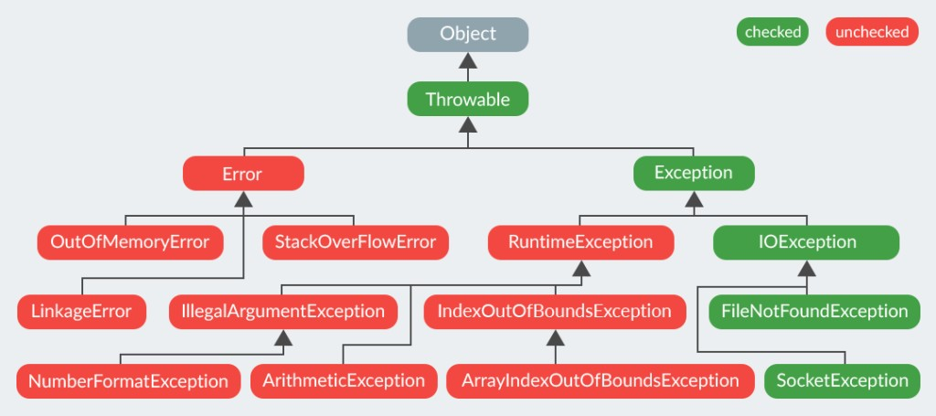
Exceptions hierarchy

Slide 4
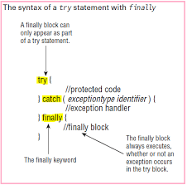
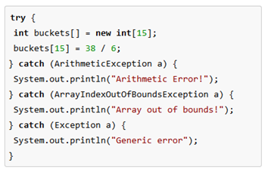
Try-catch block

Slide 5
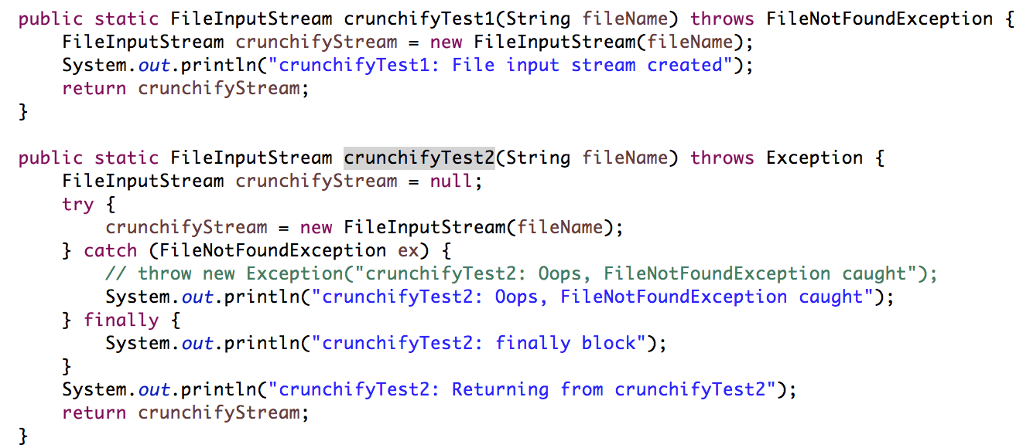
Try-catch-finally: what’s the output?

Slide 6
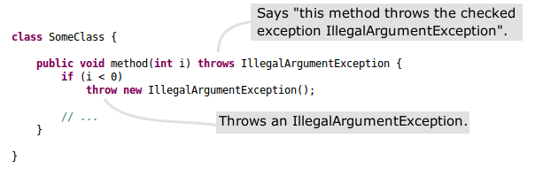
Throwing exceptions

Slide 7
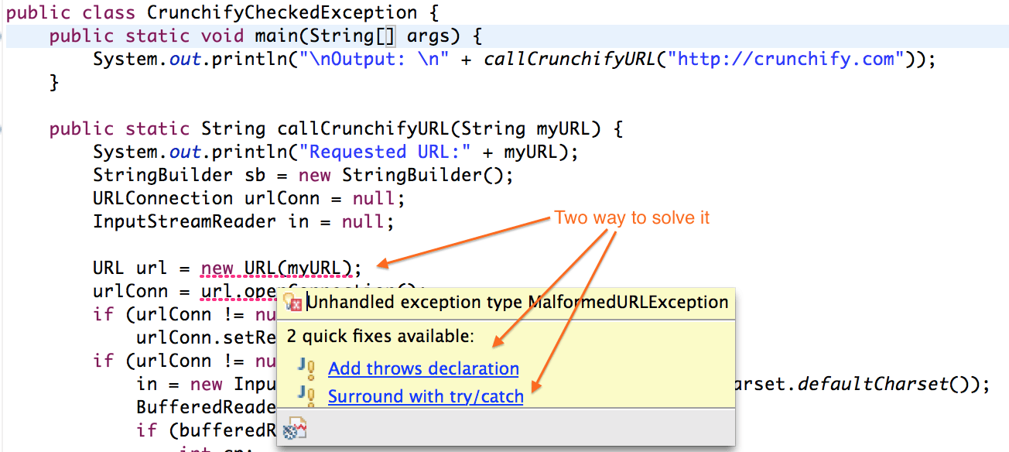
Handling checked exceptions

Slide 8
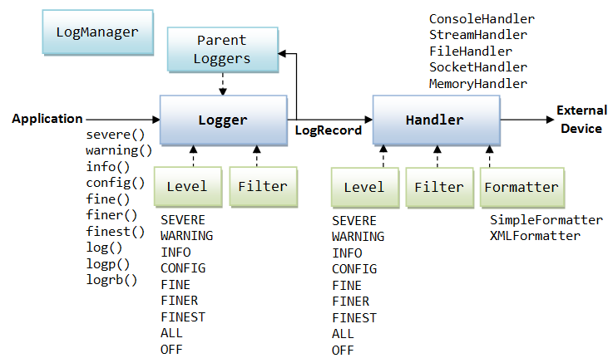
Java logging framework

Slide 9
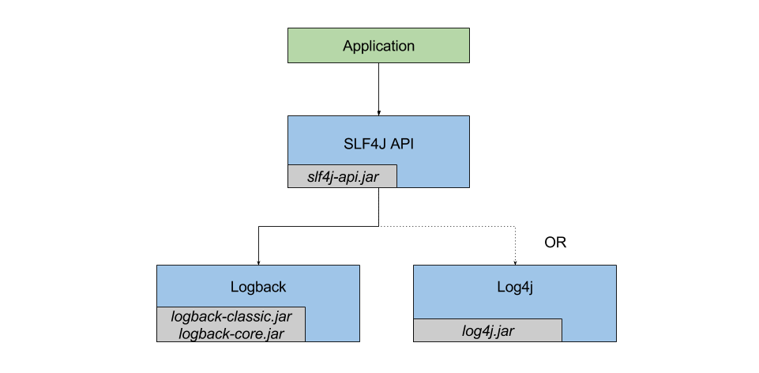
SLF4J, Log4J and logback

Slide 10
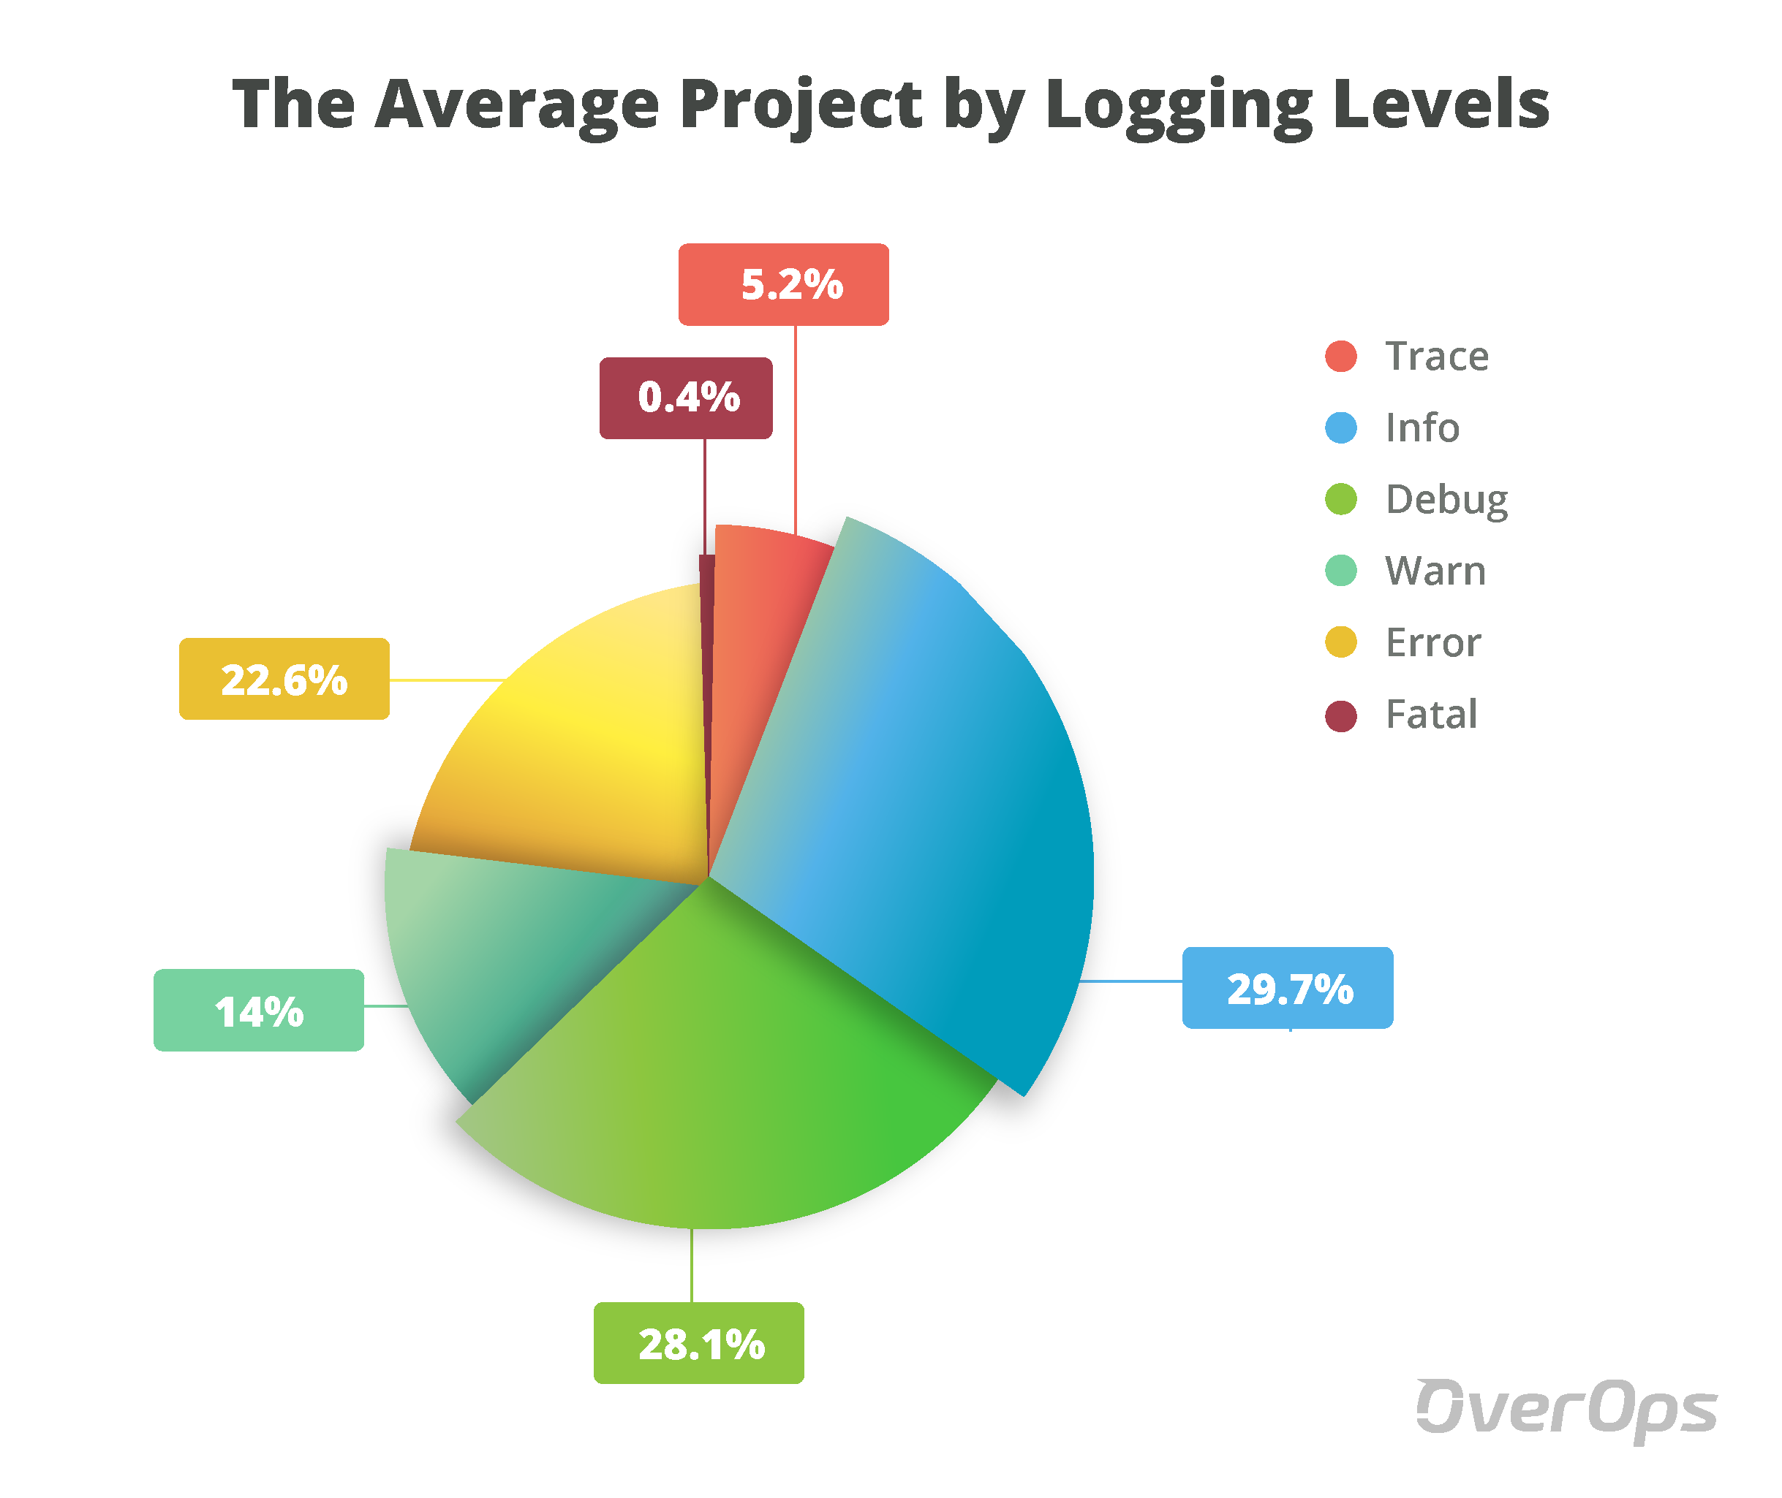
Log levels

Slide 11
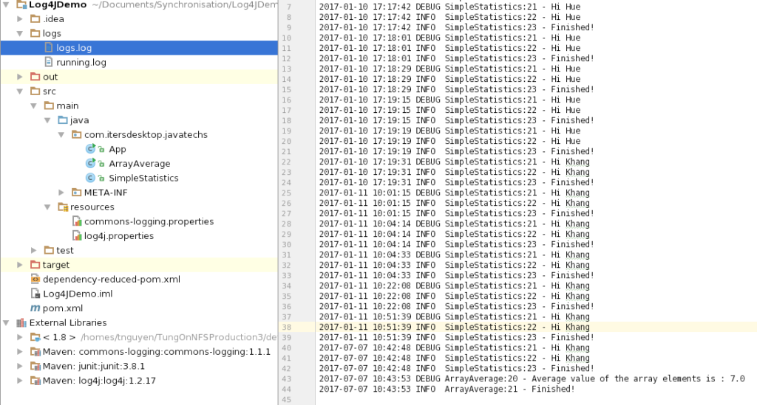
Log output

Slide 12

Logging tools

Slide 13
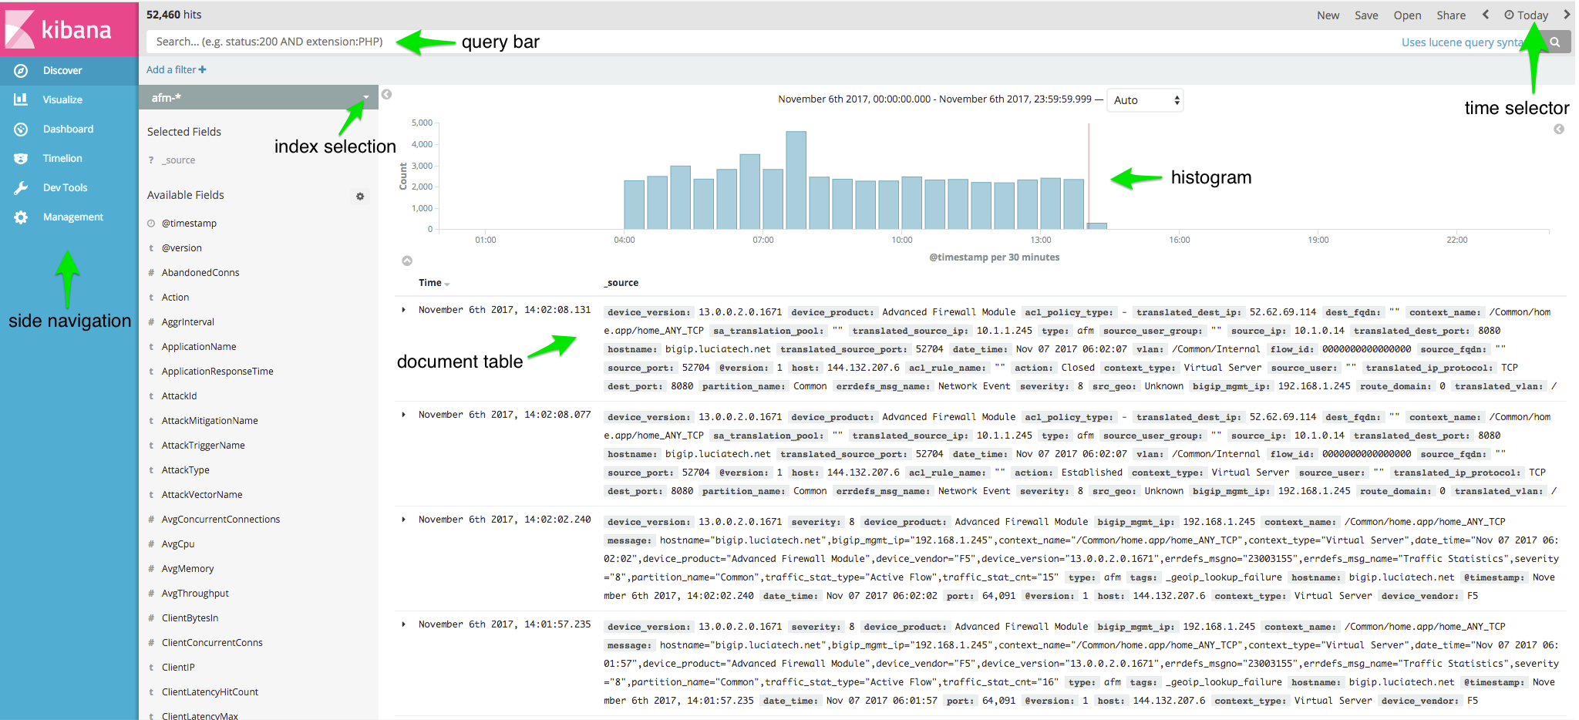
Kibana

Slide 14
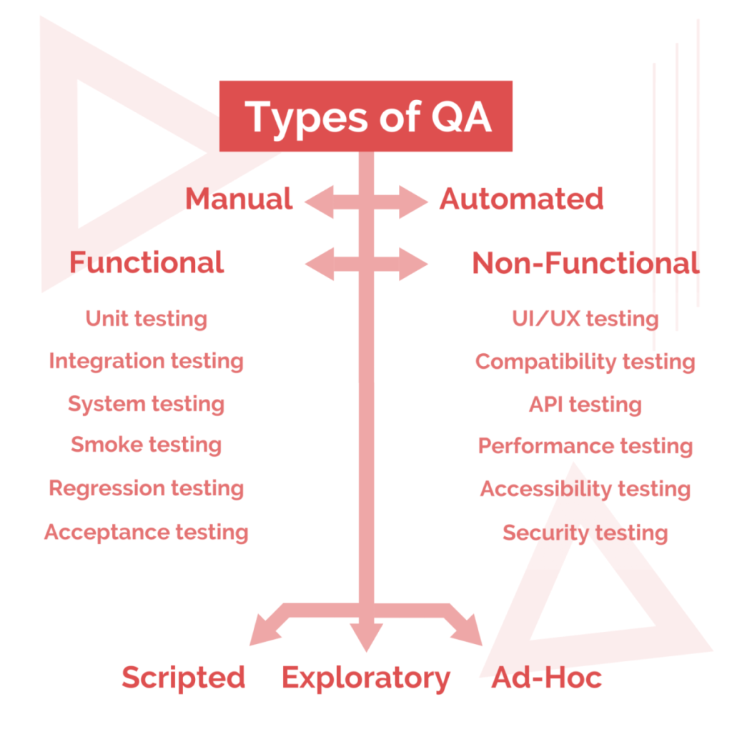
Software testing

Slide 15
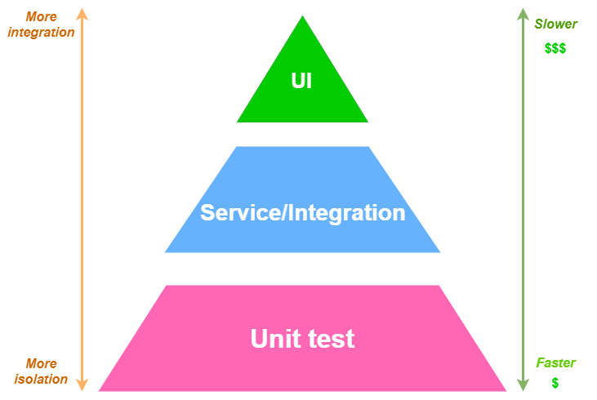
Testing pyramid

Slide 16
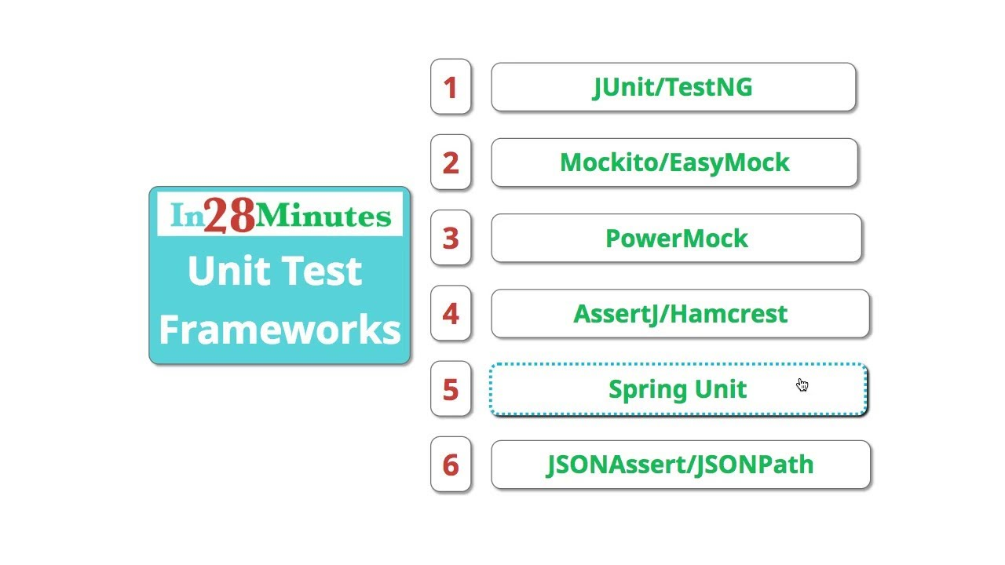
Java test frameworks

Slide 17
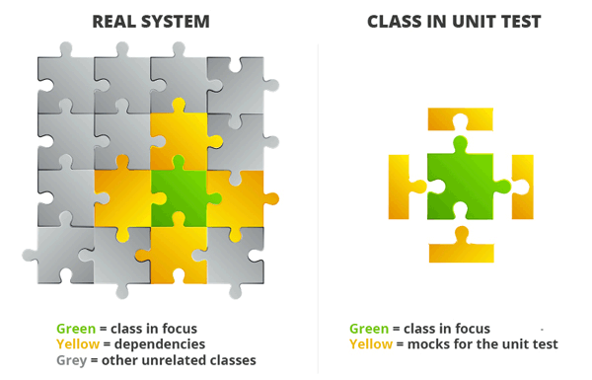
Unit test

Slide 18
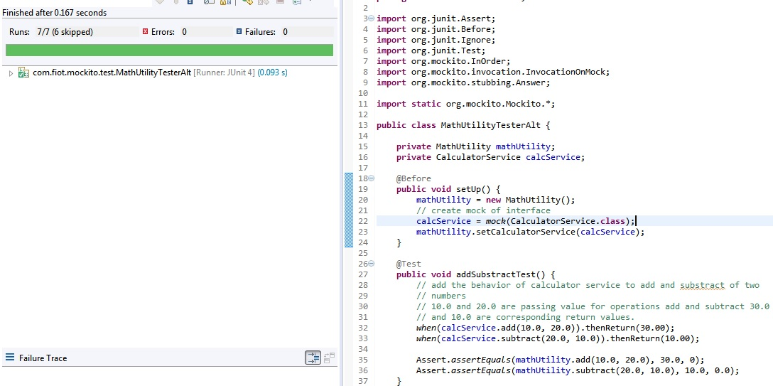
Unit test example

Slide 19
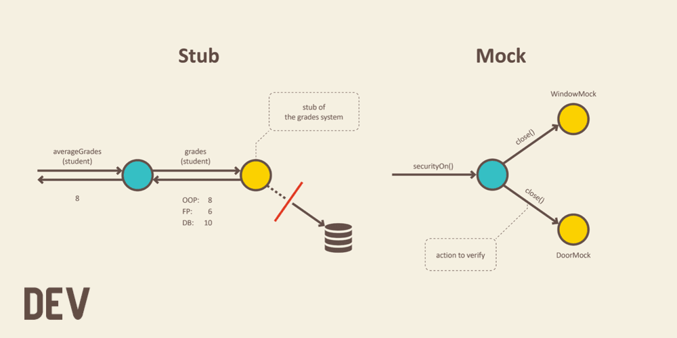
Test doubles

Slide 20
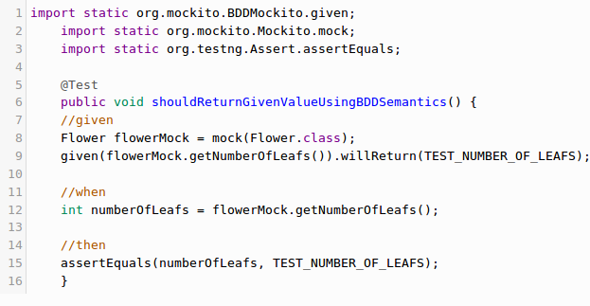
Simple Mockito example

Slide 21
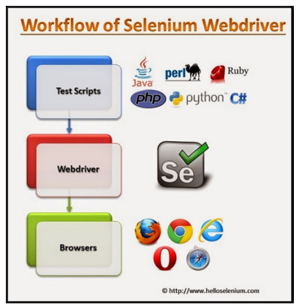
E2E testing with Selenium

Slide 22
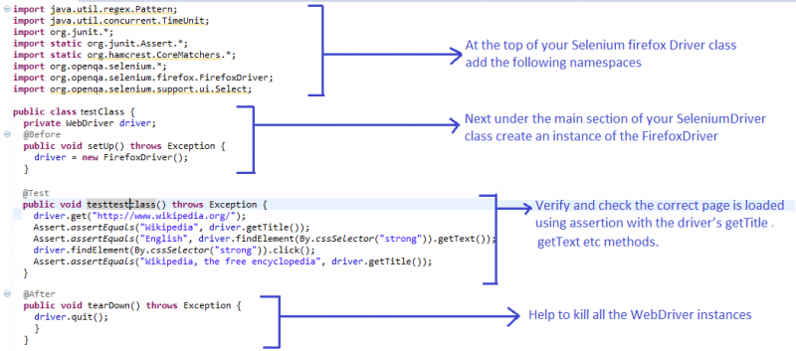
E2E testing with Selenium

Slide 23
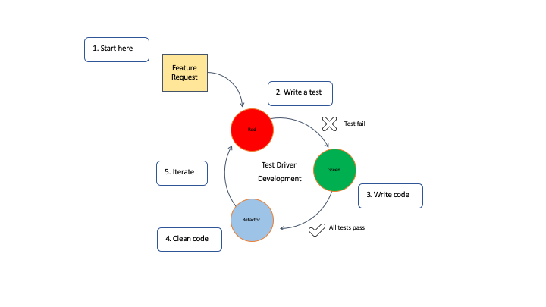
Test Driven Development

Slide 24
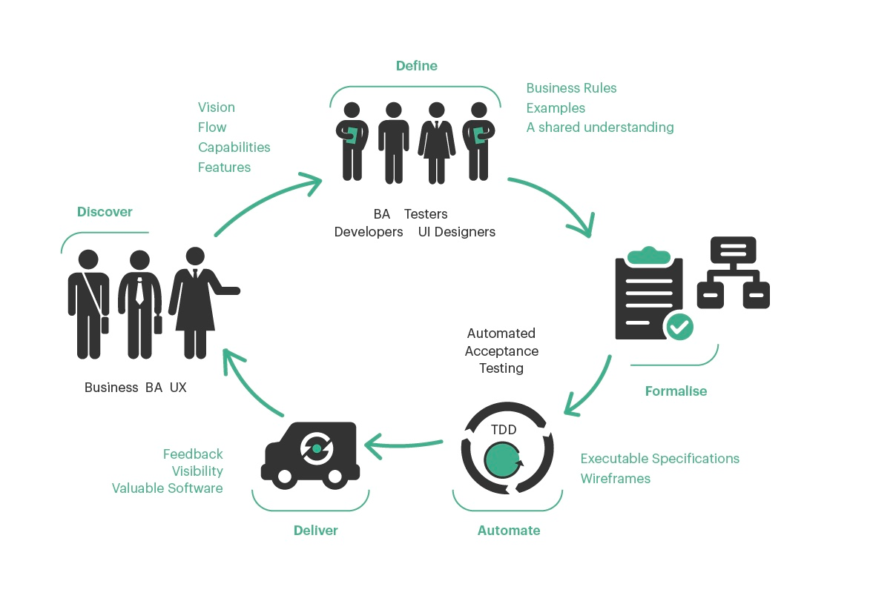
Behavior Driven Development

Slide 25
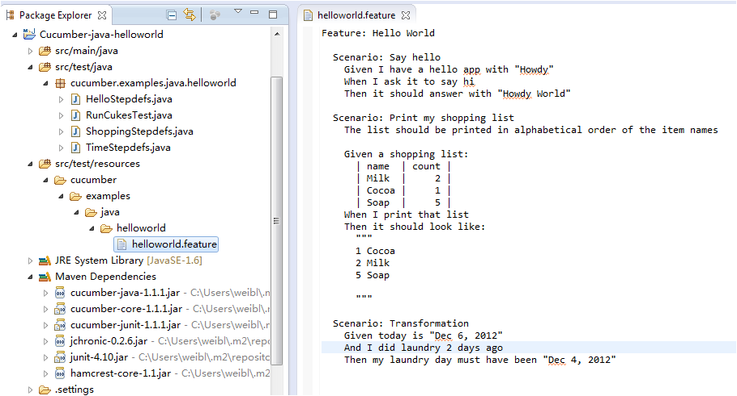
BDD: cucumber framework

Slide 26
Questions ?

